Slide 1
Configuring Hibernate

Slide 2
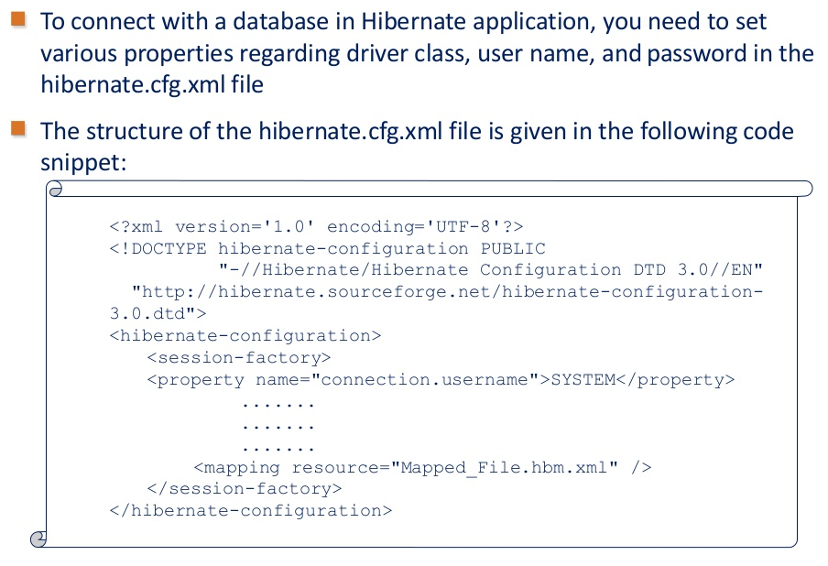
Configuring Hibernate

Slide 3
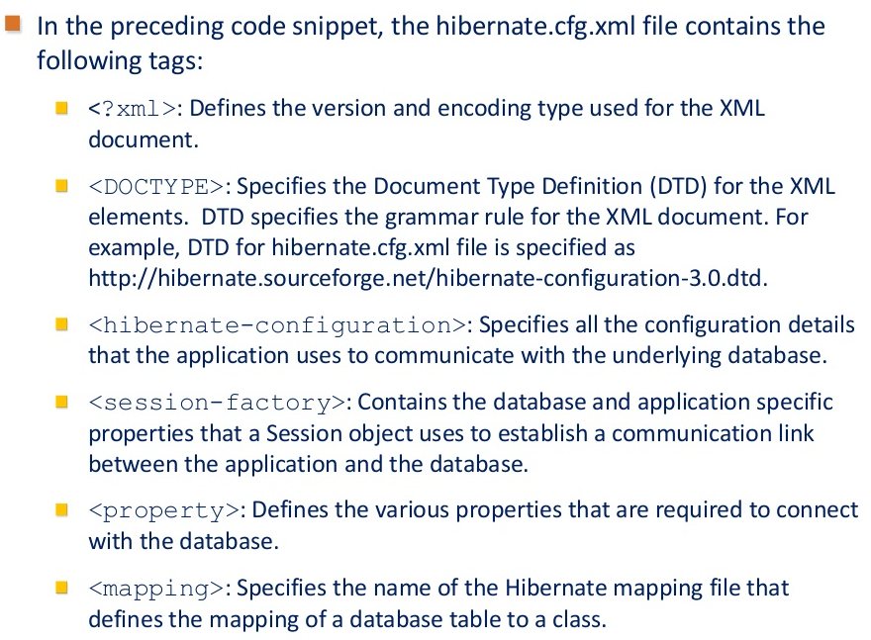
Configuring Hibernate(Contd.)

Slide 4
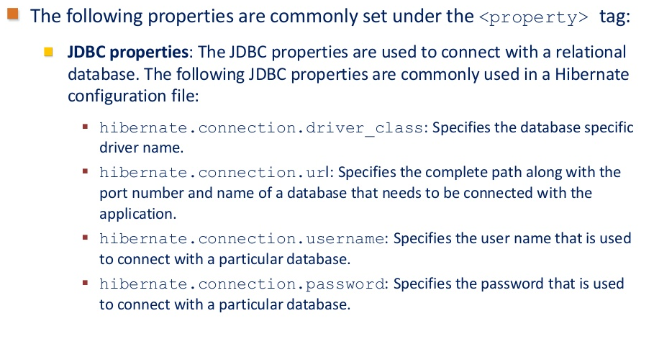
Configuring Hibernate(Contd.)

Slide 5
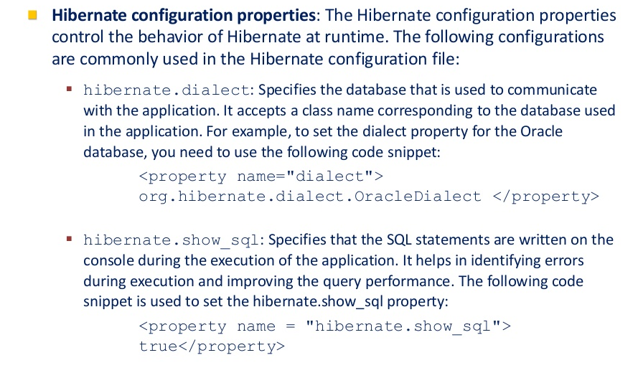
Configuring Hibernate(Contd.)

Slide 6
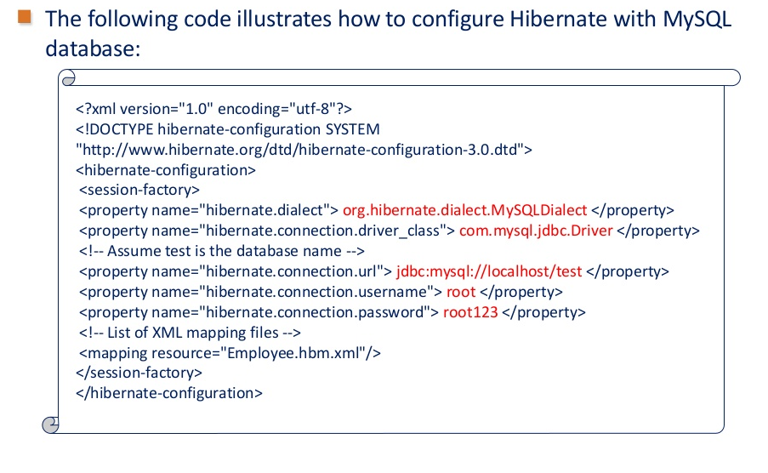
Configuring Hibernate(Contd.)

Slide 7
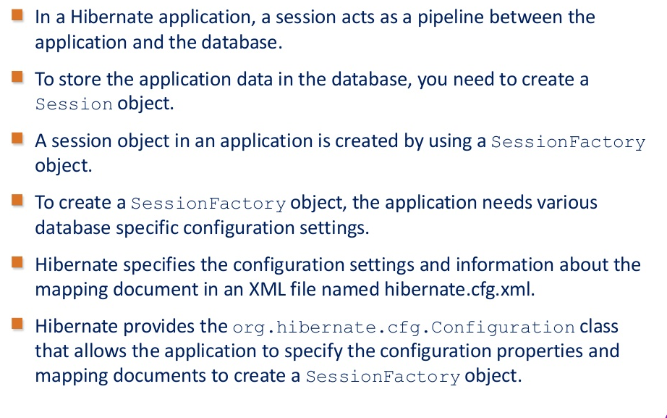
Creating Hibernate Session

Slide 8
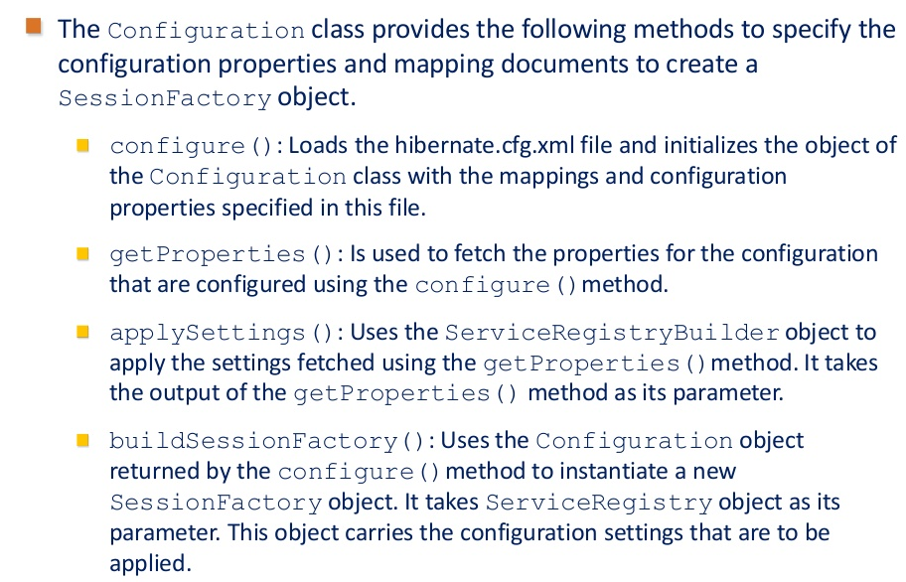
Creating Hibernate Session(Contd.)

Slide 9
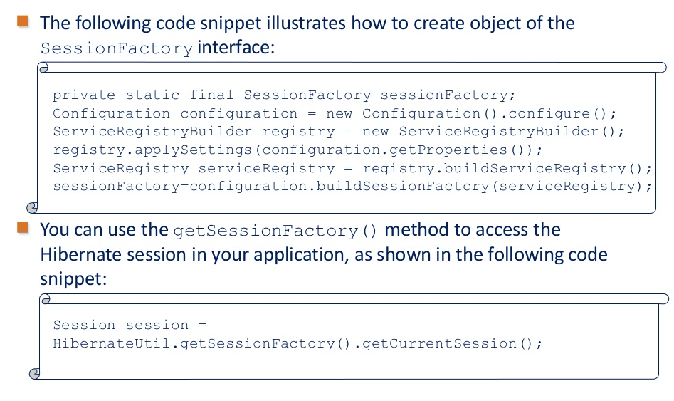
Creating Hibernate Session(Contd.)

Slide 10
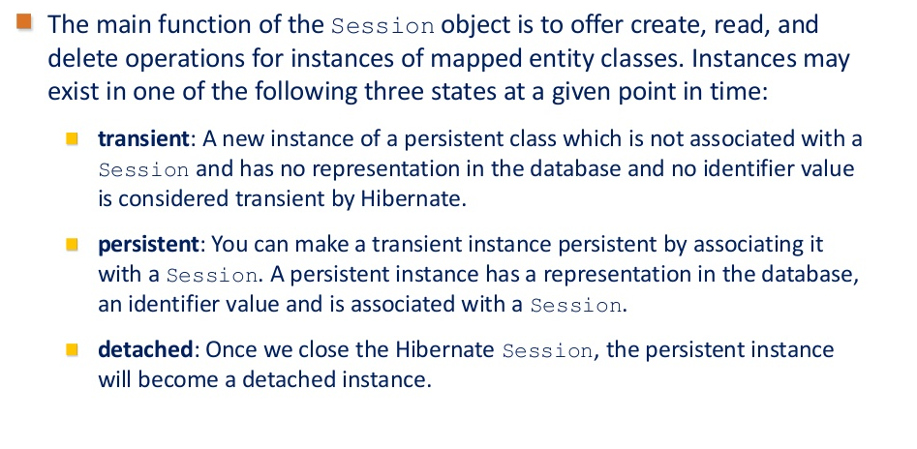
Creating Hibernate Session(Contd.)

Slide 11
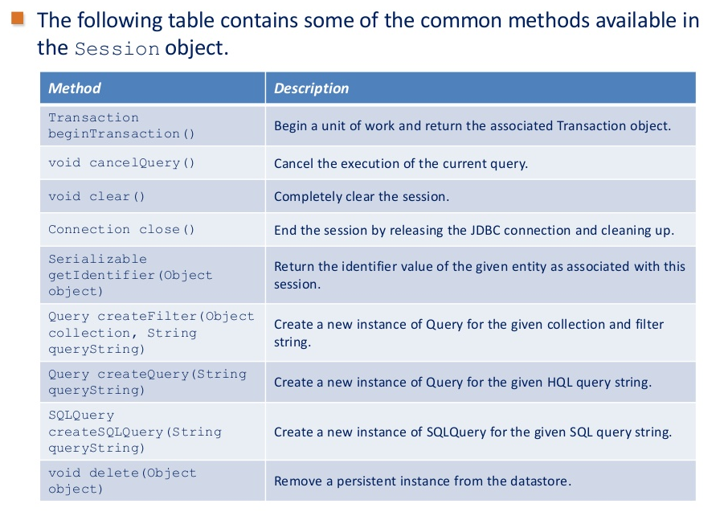
Creating Hibernate Session(Contd.)

Slide 12
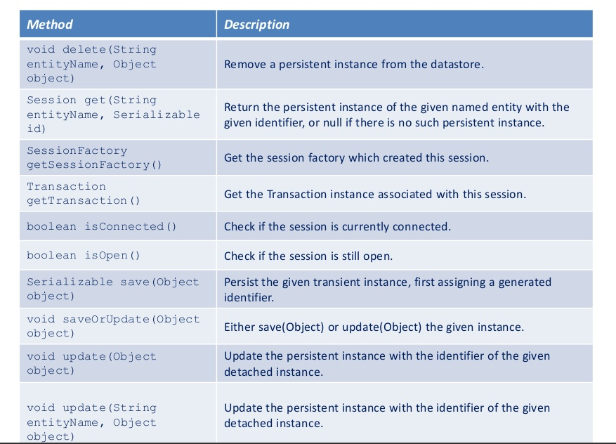
Creating Hibernate Session(Contd.)

Slide 13
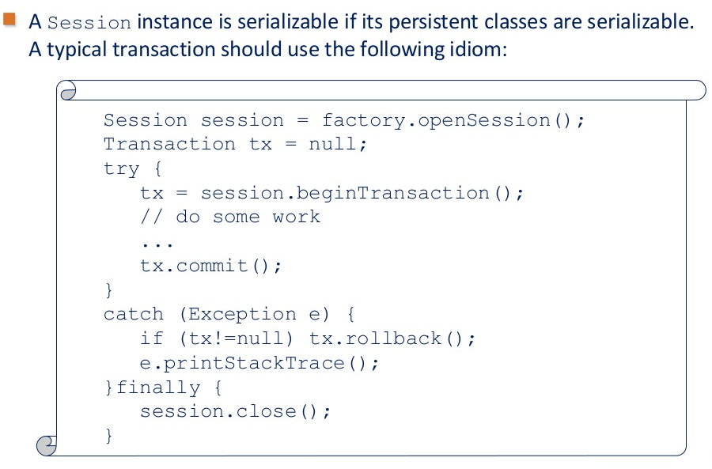
Creating Hibernate Session(Contd.)

Slide 14
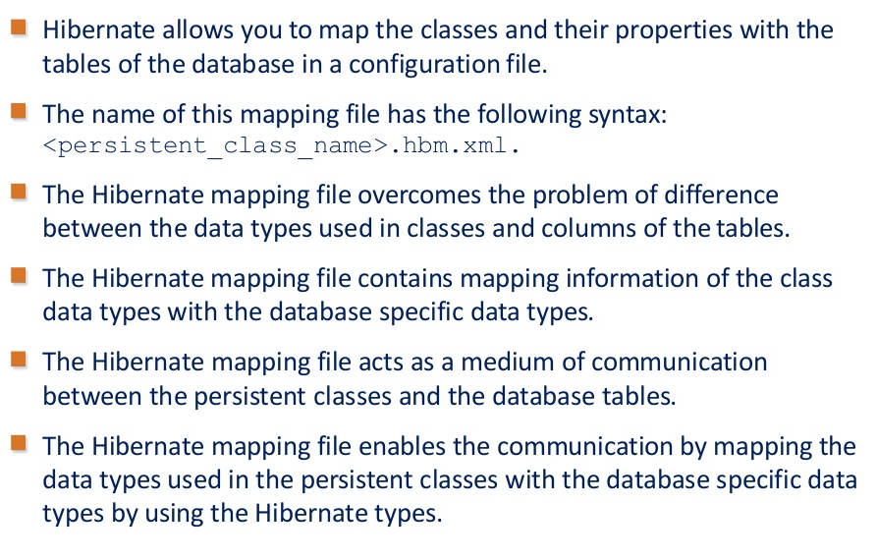
Configuring Mapping Properties

Slide 15
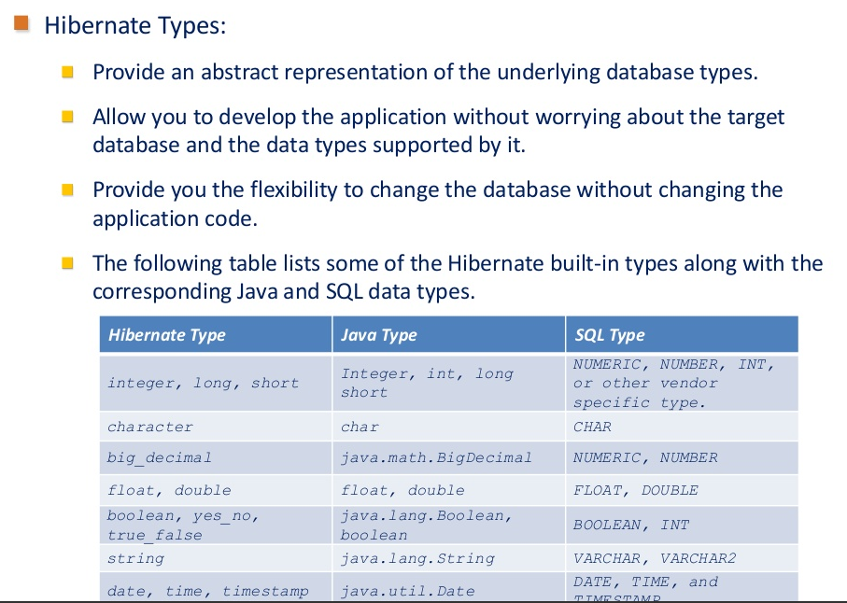
Configuring Mapping Properties(Contd.)

Slide 16
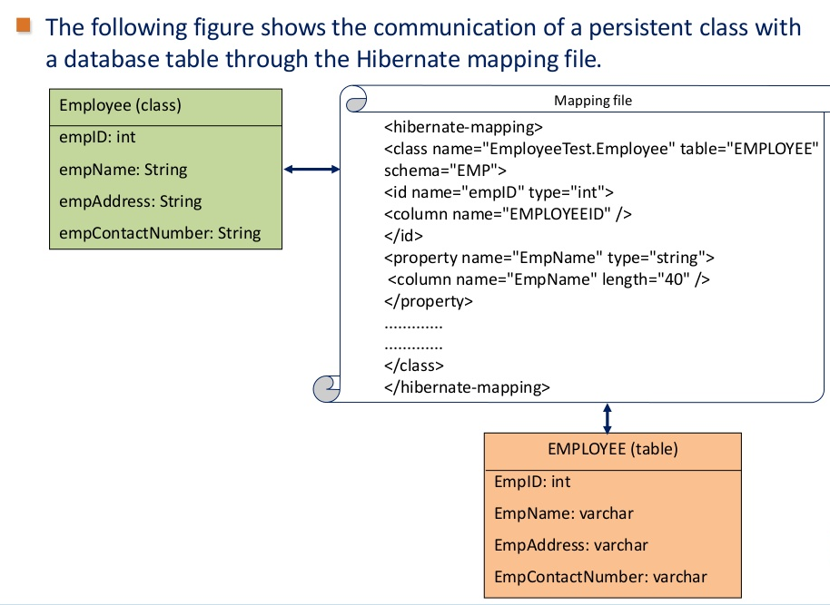
Configuring Mapping Properties(Contd.)

Slide 17
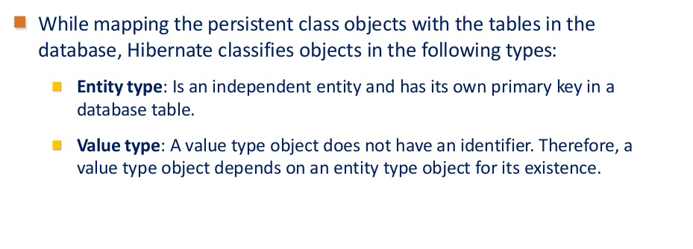
Configuring Mapping Properties(Contd.)

Slide 18
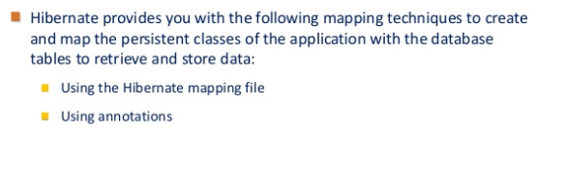
Mapping Beans with the Database

Slide 19
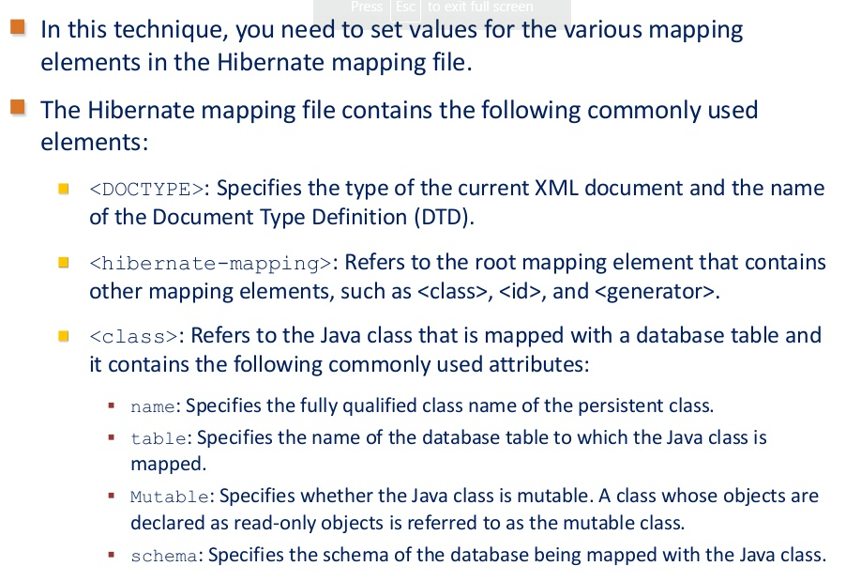
Using the Hibernate Mapping File

Slide 20
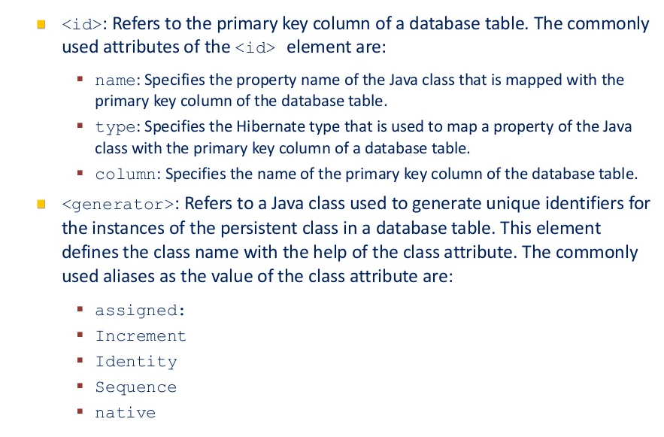
Using the Hibernate Mapping File(Contd.)

Slide 21
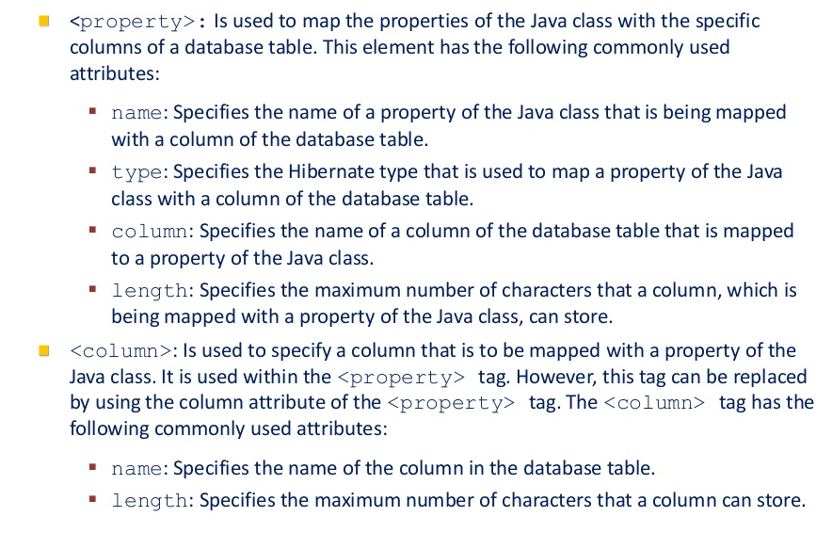
Using the Hibernate Mapping File(Contd.)

Slide 22
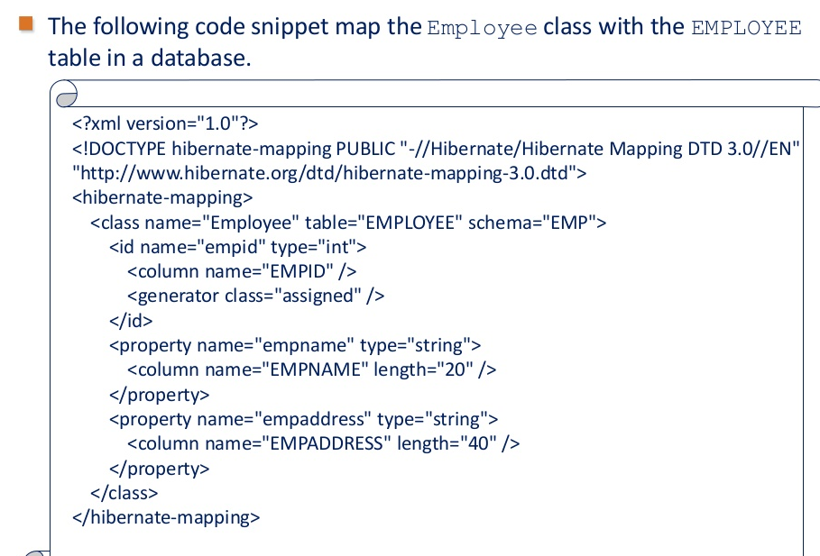
Using the Hibernate Mapping File(Contd.)

Slide 23
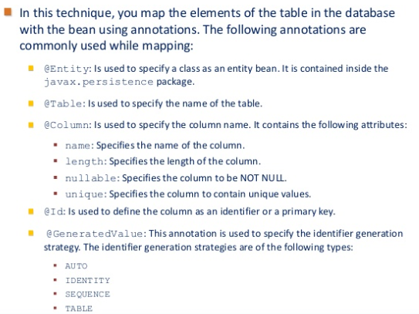
Using Annotations

Slide 24
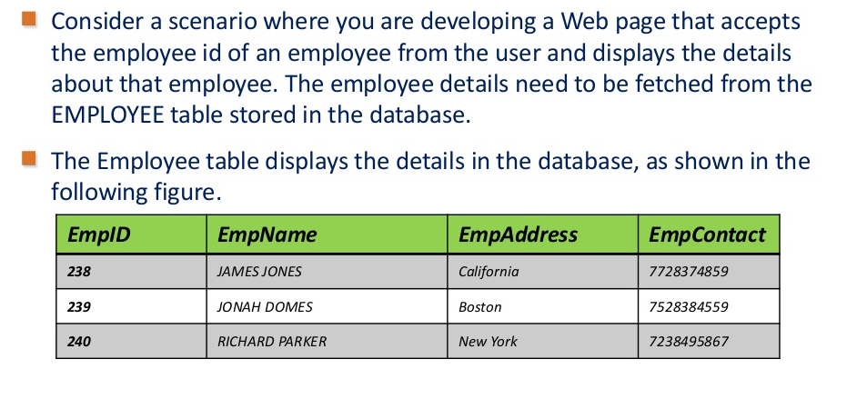
Using Annotations(Contd.)

Slide 25
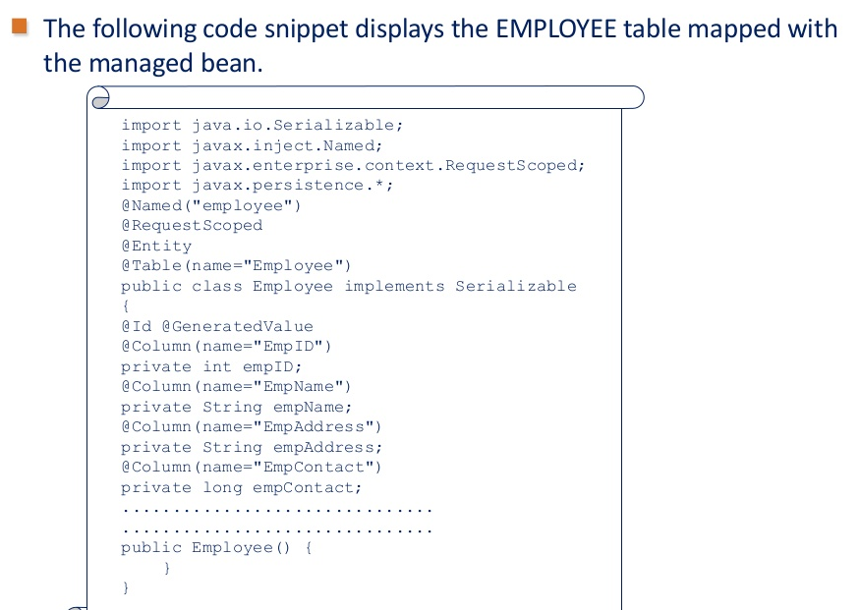
Using Annotations(Contd.)

